Slide 1
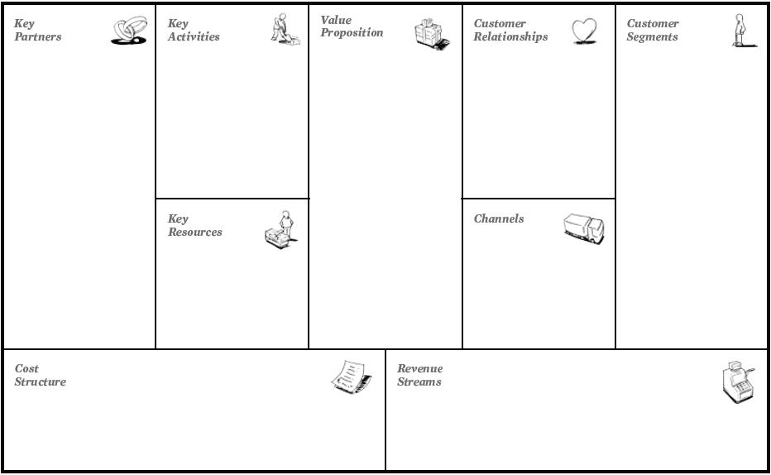
7
4
8
2
1
6
3
9
5

Slide 2
BMC - Hands-on
Propose a business model:
Product/brand picked for your Capstone project
One specific application of ChatGPT
Your understanding of as-is business model
Tesla
Zomato
LinkedIn
Notes:
BMC https://docs.google.com/presentation/d/1IQdcKMypPnLAvSJaf_fx4dS-CEUuUaAxBY_ebGvLbh0/edit?usp=sharing

Slide 3
asasasas

